Slide 1
Linear Control System EC-311
SATISH GUDAPATI
Assistant Professor
Department of Electrical & Electronics Engineering
Chalapathi Institute of Engineering & Technology

Slide 2
Module III – Stability
Introduction to Stability
Definition of Stability, Analysis of stable, unstable, critically stable
and conditionally stable
Relative Stability
Root locations in S-plane for stable and unstable system
Routh’s Stability Criterion
Routh’s Stability Criterion : Different cases and conditions
Statement Method
Numericals Problems
2

Slide 3
Module-III Stability
3

Slide 4
Specific Objectives
Appreciate the importance of stability
Analyze different types of stability
Apply Routh’s stability criterion analysis and solve the numerical.
for stability
4

Slide 5
Module III – Stability
Introduction to Stability (4 Marks)
Definition of Stability, Analysis of stable, unstable, critically stable
and conditionally stable
Relative Stability
Root locations in S-plane for stable and unstable system
Routh’s Stability Criterion (8 Marks)
Routh’s Stability Criterion : Different cases and conditions
Statement Method
Numericals Problems
5

Slide 6
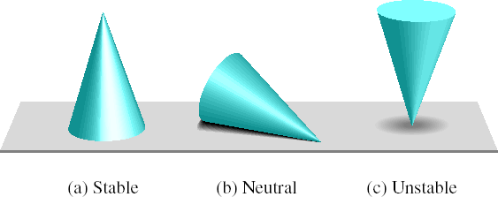
“Concept of Stability”
The concept of stability can be illustrated by a cone placed on a plane horizontal surface.
14

Slide 7
Module III – Stability
Introduction to Stability
Definition of Stability, Analysis of stable, unstable, critically
stable and conditionally stable
Relative Stability
Root locations in S-plane for stable and unstable system
Routh’s Stability Criterion
Routh’s Stability Criterion : Different cases and conditions
Statement Method
Numericals Problems
15

Slide 8
Stable System
A linear time invarient system is stable if following conditions are satisfied:
A bounded input is given to the system, the response of the system is bounded and controllable.
In the absence of the inputs, the output should tend to zero as time increases.

Slide 9
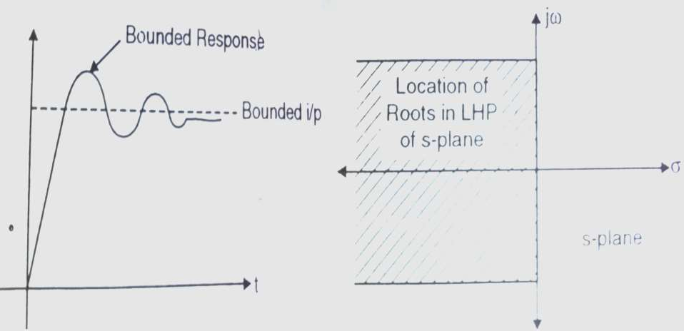
Stable System
Bounded i/p bounded o/p for stable system
Location of roots for stable system

Slide 10
Unstable System
A linear time invarient system comes under the class of unstable system if the system is excited by a bounded input, response is unbounded.
This means once any input is given system output goes on increasing & designer does not have any control on it

Slide 11
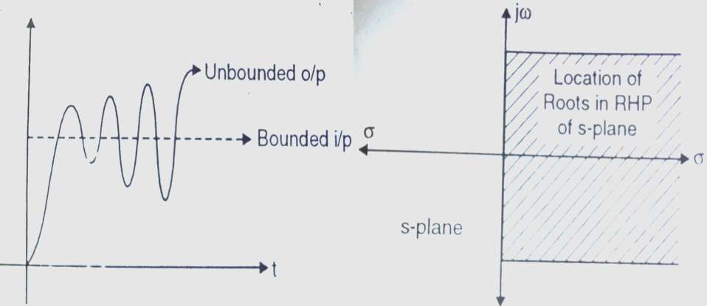
Unstable System
Bounded i/p Unbounded o/p for unstable system
Location of roots for unstable system

Slide 12
Critically Stable System
When the input is given to a linear time invarient system, for critically stable systems the output does not go on increasing infinitely nor does it go to zero as time increases.
The output usually oscillates in a finite range or remains steady at some value.
Such systems are not stable as their response does not decay to zero. Neither they are defined as unstable because their output does not go on increasing infinitely.

Slide 13
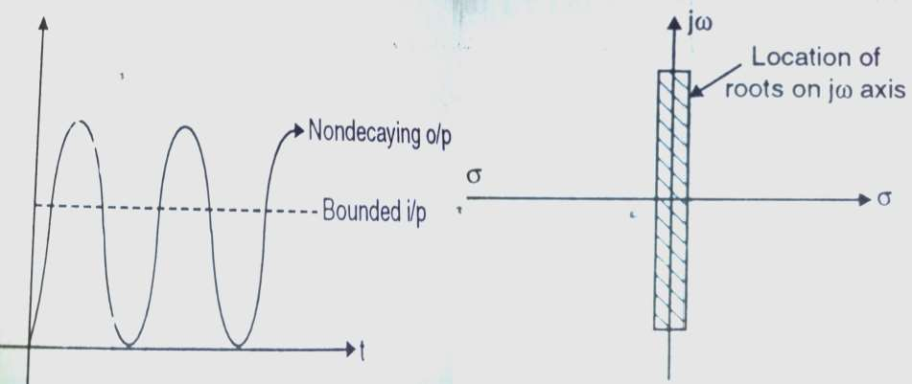
Critically stable System
Bounded i/p & o/p response for critically stable system
Location of roots
for critically stable system

Slide 14
Module III – Stability
Introduction to Stability
Definition of Stability, Analysis of stable, unstable, critically stable
and conditionally stable
Relative Stability
Root locations in S-plane for stable and unstable system
Routh’s Stability Criterion
Routh’s Stability Criterion : Different cases and conditions
Statement Method
Numericals Problems
22

Slide 15
Relative Stability
A system may be absolutely stable i.e. it may have passed the Routh stability test.
As a result their response decays to zero under zero input conditions.
The ratio at which these decay to zero is important to check the concept of “Relative stability”

Slide 16
Relative Stability
When the poles are located far away from jw axis in
LHP of s-plane, the response decays to zero much faster, as compared to the poles close to jw-axis.
The more the poles are located far away from jw-axis the more is the system relatively stable.

Slide 17
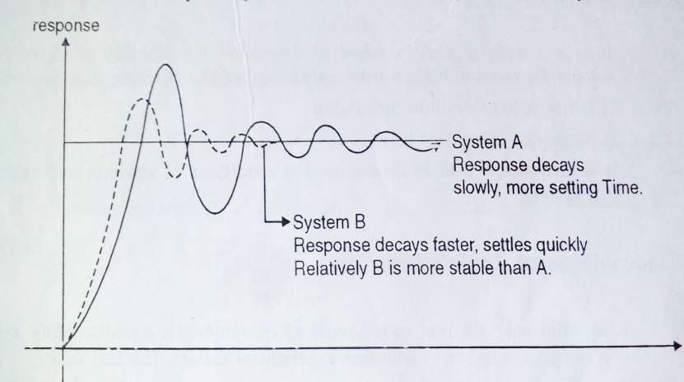
Relative Stability
Response comparison

Slide 18
jω
Relative Stability
Location of poles comparison
×
×
−σ
σ
×
×
jω
System B Complex conjugate
poles
System A Complex conjugate
poles

Slide 19
jω
Relative Stability
−σ
σ
Relative Stability improves as one moves away from jw axis
jω

Slide 20
Module III – Stability
Introduction to Stability
Definition of Stability, Analysis of stable, unstable, critically stable
and conditionally stable
Relative Stability
Root locations in S-plane for stable and unstable system
Routh’s Stability Criterion
Routh’s Stability Criterion : Different cases and conditions
Statement Method
Numericals Problems
28

Slide 21
Routh’s Stability Criterion
For the transfer function;
m m−1
C(s) ₌ b0 s + b1s
R(s) a0 s^{n} + a1s^{n−1}
+ ............... + bm
+ ............... + an
In this criterion, the coefficients of denominator are arranged in an Array called “Routh’s Array”;
a0s^{n} + a1s^{n−1} + ............... + an = 0

Slide 22
The coefficients of s^{n}and s^{n−1} row are directly written from the given equation.
a0s^{n} + a1s^{n−1} + ............... + an = 0
The Routh’s array as below;
For next row i.e. s^{n−2} ;
a 0 a2
a1 a3
a 4
a5
_{s}n
_{s}n−1
_{s}n−2
_{s}n−3
a6
a7
a1.a2 − a3a0
b1 =
a1
b1
_{s}0

Slide 23
The coefficients of s^{n} and s^{n−1} row are directly written from the given equation.
a0s^{n} + a1s^{n−1} + ............... + an = 0
For next row i.e. s^{n−2} ;
_{b1 =} a1.a2 − a3a0
The Routh’s array as below;
a 0 a2 a 4 a6
a1 a3 a5 a7
a1
_{s}n
_{s}n−1
_{s}n−2
_{s}n−3
a1.a4 − a0.a5
a1
b2 =
b1
b2
_{s}0

Slide 24
The coefficients of
_{s}n
and s^{n−1} row are directly written from the given equation.
a0s^{n} + a1s^{n−1} + ............... + an = 0
For next row i.e. s^{n−2} ;
_{b1 =} a1.a2 − a3a0
The Routh’s array as below;
a 0 a2
a1 a3
a 4
a5
b2 b3
a1
_{s}n
_{s}n−1
_{s}n−2
_{s}n−3
a6
a7
a1.a4 − a .0 a5
b2 =
a1
b1
a1.a6 − a0.a7
b3 =
a1
_{s}0

Slide 25
Now the same technique is used, for the next row i.e. s^{n−3} row, but
_{s}n−1
_{s}n−2
only previous two rows are used i.e. and
For next row i.e. s^{n−2} ;
The Routh’s array as below;
a1.a2 − a3a0
b1 =
a1
a1.a4 − a0.a5
a 0 a2
a1 a3
a 4
a5
b2 b3
_{s}n
_{s}n−1
_{s}n−2
_{s}n−3
a6
a7
b2 =
a1
a1.a6 − a0.a7
b3 =
b1
c1
a1
For next row i.e. s
n−3
;
b1.a3 − b2a1
c1 =
b1
_{s}0

Slide 26
Now the same technique is used, for the next row i.e. s^{n−3}row, but
_{s}n−1
_{s}n−2
only previous two rows are used i.e. and
For next row i.e. s^{n−2} ;
The Routh’s array as below;
a1.a2 − a3a0
b1 =
a1
a1.a4 − a0.a5
a 0 a2
a1 a3
a 4
a5
b2 b3
c2
_{s}n
_{s}n−1
_{s}n−2
_{s}n−3
a6
a7
b2 =
a1
a1.a6 − a0.a7
b3 =
b1
c1
a1
For next row i.e. s
n−3
;
b1.a3 − b2a1
b1
c1 =
_{s}0
_{c2 =} b1.a5 − b3a1
b1
34

Slide 27
Each column will reduce by one as we move down the array.
a 0 a2
a1 a3
_{s}n
_{s}n−1
_{s}n−2
_{s}n−3
a 4
a5
b2 b3
c2
a6
a7
b1
c1
This process is obtained till last row is obtained.
_{s}0
an

Slide 28
Routh’s Criterion
Must have same sign
The necessary & sufficient conditions for a system to be stable is all terms in the
a 0 a2
a1 a3
a 4
a5
b2 b3
c2
_{s}n
_{s}n−1
_{s}n−2
_{s}n−3
a6
a7
first Array sign.
column at Routh’s should have same
b1
c1
There should not be any sign change in first column.
_{s}0
an

Slide 29
Routh’s Criterion
When there are sign changes in the first column of Routh’s array then the system is unstable.
There are roots in RHP.
+ a 0 a2
₊ a1 a3
- b1
+ c1
a 4
a5
b2 b3
c2
_{s}n
_{s}n−1
_{s}n−2
_{s}n−3
a6
a7
The number of sign changes equal the number of roots in RHP.
_{s}0
an

Slide 30
Example 1
_{s}3
a 0
+ 6s² + 12s + 8 = 0
a1 a2 a3
_{s}3
1
12
_{s}2
6
b1
an
8
b2
_{s}1
_{s}0

Slide 31
Example 1
cont……
_{s}3
1
12
a1.a2 − a3.a0
b1 =
_{s}2
a1
6
b1
an
8
b2
_{s}1
_{s}0

Slide 32
Example 1
cont……
_{s}3
1
12
_{b1 =} (6 ×12) − (8×1)
_{s}2
6
6
b1
an
8
b2
_{s}1
_{s}0

Slide 33
Example 1
cont……
_{s}3
1
12
0
_{s}2
6
8
b2
0
_{s}1
_{s}0
10.67
an
a1.a4 − a0.a5
b2 =
a1

Slide 34
Example 1
cont……
_{s}3
1
12
0
_{s}2
6
8
b2
0
_{s}1
_{s}0
10.67
an
1× 0 − 6 × 0
b2 =
6

Slide 35
Example 1
cont……
_{s}3
1
12
0
_{s}2
6
8
0
_{s}1
_{s}0
10.67
0
an
10.67 × 8 − 6 × 0
b2 =
10.67

Slide 36
Example 1
cont……
_{s}3
+ 6s²
+ 12s + 8 = 0
_{s}3
1
12
0
_{s}2
6
8
0
_{s}1
_{s}0
10.67
0
8

Slide 37
Example 1
cont……
Elements in first column are of same sign
1 | 12 | 0
6 | 8 | 0
10.67 | 0
8
_{s}3
_{s}2
_{s}1
_{s}0
As all elements in first column are of same sign. Hence system is stable

Slide 38
Example 2
Comment on stability.
s⁴ + 2s³ + 6s² +10s + 3 = 0
_{s}4
1
2
6
10
3
0
a1.a2 − a3.a0
b1 =
_{s}3
a1
_{s}2
_{s}1
b1
b2
(2 × 6) − (1×10)
b1 =
2
c1
_{s}0
an
b1 = 1

Slide 39
Example 2
cont….
_{s}4
1
2
6
10
a1.a4 − a0.a5
3
0
b2 =
a1
_{s}3
_{s}2
_{s}1
_{b2 =} 2 × 3 −1× 0
1
c1
b2
2
_{s}0
an
b2 = 3

Slide 40
Example 2
cont….
b1.a3 − b2a1
_{s}4
1
2
6
10
c1 =
3
0
b1
_{s}3
1×10 − 2 × 3
_{s}2
_{s}1
c1 =
1
c1
3
1
_{s}0
an
c1 = 4

Slide 41
Example 2
cont….
c1.b 2 − b1c2
_{s}4
1
2
6
10
an =
3
0
c1
_{s}3
4 × 3 −1× 0
_{s}2
_{s}1
an =
1
3
4
4
an
_{s}0
an = 3

Slide 42
Example 2
cont….
_{s}4
1
2
6
10
3
0
As no sign change in first column; system is stable
_{s}3
_{s}2
_{s}1
1
3
4
3
_{s}0

Slide 43
Example 3
Comment on stability.
2s³ + 4s² + 4s +12 = 0
_{s}3
2
4
a1.a2 − a3.a0
0
b1 =
a1
_{s}2
_{s}1
12
4
b1
an
_{b1 =} (4 × 4) − (2 ×12)
b2
4
_{s}0
b1 = −2

Slide 44
Example 3
cont….
_{s}3
2
4
0
(4 × 0) − (2 × 0)
b2 =
_{s}2
_{s}1
4
4
−2
an
12
b2
b2 = 0
_{s}0

Slide 45
Example 3
cont….
_{s}3
2
4
0
(−2 ×12) − (4 × 0)
an =
_{s}2
_{s}1
−2
4
−2
an
12
0
an = 12
_{s}0

Slide 46
Example 3
cont….
_{s}3
2
4
0
_{s}2
_{s}1
12
4
−2
There are two sign changes
+4 to -2 and -2 to +12. Hence two roots are in RHP
S-plane and system is unstable
0
_{s}0
12

Slide 47
Example 4
Comment on stability.
s⁵ + 2s⁴ + 4s³ + 6s² + 2s + 5 = 0
_{b1 =} (2 × 4) − (6 ×1)
2
b1 = 1
_{b2 =} (2 × 2) − (5×1)
2
b2 = −0.5
_{s}5
_{s}4
_{s}3
_{s}2
_{s}1
1 | 4 | 2
2 | 6 | 5
b1 | b2
c1 d1 | c 2
_{s}0
an

Slide 48
Example 4
cont…..
_{c1 =} (1× 6) − (−0.5× 2)
_{s}5
_{s}4
1
2
4
6
−0.5
2
5
1
c1 = 7
_{s}3
1
(1× 5) − (0 × 2)
_{s}2
_{s}1
c1 c 2
d1
an
c2 =
1
c2 = 5
_{s}0

Slide 49
Example 4
cont…..
_{s}5
_{s}4
1
2
4
6
−0.5
2
5
(7 × −0.5) − (5×1)
d1 =
7
_{s}3
1
7
d1
an
d1 = −1.21
_{s}2
_{s}1
5
_{s}0

Slide 50
Example 4
cont…..
_{s}5
_{s}4
1
2
4
6
−0.5
2
5
(5× −1.21) − (7 × 0)
an =
−1.21
_{s}3
1
an = 5
_{s}2
_{s}1
7
−1.21
an
5
_{s}0

Slide 51
Example 4
cont…..
_{s}5
_{s}4
1
2
4
6
−0.5
2
5
There are two sign changes
+7 to -1.21 and -1.21 to +5.
Hence two roots are in RHP
S-plane and system is unstable
_{s}3
1
_{s}2
_{s}1
7
−1.21
5
_{s}0
5

Slide 52
Example 5
Comment on stability.
s⁵ + s⁴ + 2s³ + 2s² + 3s + 5 = 0
_{b1 =} (1× 2) − (2×1)
1
b1 = 0
_{b2 =} (1× 3) − (5×1)
1
b2 = −2
_{s}5
_{s}4
_{s}3
_{s}2
_{s}1
1 | 2 | 3
1 | 2 | 5
b1 | b2
c1 d1 | c 2
_{s}0
an

Slide 53
Example 5
cont…..
Comment on stability.
s⁵ + s⁴ + 2s³ + 2s² + 3s + 5 = 0
_{s}5
_{s}4
_{s}3
1 | 2 | 3
1 | 2 | 5
0 | −2
c1 | c 2
_{s}2
_{s}1
d1
an
Case I – “When the first of any row is zero and the rest of the row is non-zero.”
_{s}0

Slide 54
Routh’s Criterion Special Cases
Case I – “When the first of any row is zero and the rest of the row is non-zero.” Here the next row cannot be formed as division by 0 will take place.
Method to Overcome: A method to overcome
1
above problem is to replace s by and complete the Routh’s test for z.
z

Slide 55
Example 5
cont…..
Replace s by (1/z)
1 1
1
1
1
5 4 3 2
( ) + ( ) + 2( ) + 2( ) + 3( ) + 5 = 0
z
z
z
z
z
Take L.C.M
1 + z + 2z ² + 2z³ + 3z ⁴ + 5z⁵
_{z}5
= 0
1+ z + 2z² + 2z³ + 3z⁴ + 5z⁵ = 0
5z⁵ + 3z⁴ + 2z³ + 2z² + z +1 = 0
Use above characteristics equation and complete Routh’s Test

Slide 56
Example 5
cont…..
_{z}5
5
2
1
1
_{z}4
3
2
4
3
2
3
_{z}3
−
−
There are two sign changes in first column.
Hence two roots are in RHP
S-plane and system is unstable
1
_{z}2
2
2
1
1
_{z}1 _{z}0

Slide 57
Example 6
Comment on stability.
s⁴ + 6s³ +11s² + 6s +10 = 0
_{b1 =} (6 ×11) − (1× 6)
6
_{s}4
1
6
11
6
10
0
_{s}3
b1 = 10
_{s}2
b1
b2
_{b2 =} (6 ×10) − (1× 0)
6
s
1
c1
_{s}0
an
b1 = 10

Slide 58
Example 6
cont….
_{c1 =} (10 × 6) − (10 × 6)
10
_{s}4
1
6
11
6
10
0
_{s}3
c1 = 0
_{s}2
_{s}1
10
10
c1
_{s}0
an

Slide 59
Example 6
cont….
_{c1 =} (10 × 6) − (10 × 6)
10
_{s}4
1
6
11
6
10
0
_{s}3
c1 = 0
_{s}2
_{s}1
10
10
0
an
_{s}0
Case II – “When all elements in any one row is zero.”

Slide 60
Routh’s Criterion Special Cases
Case II – “When all elements in any one row is zero.”
Method to Overcome:
Here form an auxillary equation with the help of the coefficients of the coefficients of the row just above the row of zeros.
Take the derivative of this equation and replace it’s coefficients in the present row of zeros.
Then proceed for Routh’s test.

Slide 61
Example 6
cont….
Here s¹ row breaks down. Hence write auxiliary equation for s² .
A(s) = 10s² +10
(Note each term of next column differs by degree of 2)
_{s}4
1
6
11
6
10
0
_{s}3
_{s}2
_{s}1
10
10
0
an
Take derivative of auxiliary equation
_{s}0
^{d} A(s) = 20s
ds
Use these for s row coefficients.

Slide 62
Example 6
cont….
_{s}4
1
6
11
6
10
0
_{an =} (20 ×10) − (10 × 0)
20
an = 10
s
3
_{s}2
_{s}1
10
10
20
an
_{s}0

Slide 63
Example 6
cont….
_{s}4
1
6
11
6
10
0
As no sign change in first column; system is stable
_{s}3
_{s}2
_{s}1
10
10
20
10
_{s}0

Slide 64
Example 7
Comment on stability.
s⁶ + 3s⁵ + 5s⁴ + 9s³ + 8s² + 6s + 4 = 0
(3× 5) − (9 ×1) 3
_{s}6
_{s}5
_{s}4
¹ 5 8
3 9 6
b1 b2 b3
4
b1 =
b1 = 2
_{b2 =} (3× 8) − (6 ×1)
c1 c 2
d1
e1
an
3
b2 = 6
_{s}3
_{s}2 _{s}1 _{s}0
(3× 4) − (0 ×1) 3
b3 = 4
b3 =

Slide 65
Example 7
cont….
_{s}6
_{s}5
_{s}4
1 | 5 | 8 | 4
3 | 9 | 6
2 | 6 | 4
c1 | c 2
d1
(2 × 9) − (3× 6)
c1 =
2
c1 = 0
_{s}3
_{s}2 _{s}1 _{s}0
_{c2 =} (2 × 6) − (4 × 3)
2
e1
an
c2 = 0

Slide 66
Example 7
cont….
_{s}6
_{s}5
_{s}4
1
3
2
5
9
6
8
6
4
Here s³ row breaks down. Hence write auxiliary equation for s⁴ .
A(s) = 2s⁴ + 6s² + 4
(Note each term of next column
differs by degree of 2)
4
_{s}3
_{s}2 _{s}1 _{s}0
0
d1
e1
an
0
Take derivative of auxiliary equation
^{d} A(s) = 8s³ + 12s
ds
Use these for s³ row coefficients.

Slide 67
Example 7
cont….
_{s}6
_{s}5
_{s}4
1 | 5 | 8 | 4
3 | 9 | 6
2 | 6 | 4
8 | 12
d1 | d 2
e1 an
(8× 6) − (12 × 2)
d1 =
8
d1 = 3
_{s}3
_{s}2 _{s}1 _{s}0
(8× 4) − (0 × 2)
d 2 =
8
d 2 = 4

Slide 68
Example 7
cont….
_{s}6
_{s}5
_{s}4
1 | 5 | 8 | 4
3 | 9 | 6
2 | 6 | 4
8 | 12
3 | 4
_{e1 =} (3×12) − (8× 4)
3
_{s}3
_{s}2 _{s}1 _{s}0
e1 = 4
e1
an

Slide 69
Example 7
cont….
_{s}6
_{s}5
_{s}4
1 | 5 | 8 | 4
3 | 9 | 6
2 | 6 | 4
8 | 12
3 | 4
_{an =} (4 × 4) − (3× 0)
4
_{s}3
_{s}2 _{s}1 _{s}0
an = 4
4
an

Slide 70
Example 7
cont….
_{s}6
_{s}5
_{s}4
1 | 5 | 8 | 4
3 | 9 | 6
2 | 6 | 4
8 | 12
3 | 4
4
4
As no sign change in first column; system is stable
_{s}3
_{s}2 _{s}1 _{s}0

Slide 71
Example 8
Comment on stability.
s⁶ + 2s⁵ + 8s⁴ +12s³ + 20s² +16s +16 = 0
_{s}6
_{s}5
_{s}4
(2 × 8) − (12 ×1)
1 | 8 | 20 16
2 | 12 | 16
b1 | b2 | b3
c1 | c 2
d1
b1 =
2
b1 = 2
_{b2 =} (2 × 20) − (16 ×1)
_{s}3
_{s}2 _{s}1 _{s}0
2
b2 = 12
e1
an
(2 ×16) − (0 ×1)
b3 =
2
b3 = 16

Slide 72
Example 8
cont…..
_{c1 =} (2 ×12) − (2 ×12)
_{s}6
_{s}5
_{s}4
2
1 | 8 | 20 | 16
2 | 12 | 16
2 | 12 | 16
c1 | c 2 | c3
d1
c1 = 0
(2×16) − (2×16)
c2 =
_{s}3
_{s}2
_{s}1
2
c2 = 0
e1
an
_{c3 =} (2 × 0) − (2 × 0)
2
s
0
c3 = 0
80

Slide 73
Example 8
cont…..
_{s}6
_{s}5
_{s}4
Here s³ row breaks down. Hence write auxiliary equation for s⁴ .
A(s) = 2 s⁴ + 12 s² + 16
(Note each term of next column differs by degree of 2)
1 | 8 | 20 | 16
2 | 12 | 16
2 | 12 | 16
0 d1 | 0 | 0
_{s}3
_{s}2 _{s}1 _{s}0
Take derivative of auxiliary equation
e1
an
^{d} A(s) = 8s³ + 24s
ds
Use these for s³ row coefficients.

Slide 74
Example 8
cont…..
_{s}6
_{s}5
_{s}4
1
2
2
8 20
12 16
12 16
(8×12) − (24 × 2)
16
d1 =
8
d1 = 6
_{s}3
_{s}2 _{s}1 _{s}0
8
d1
e1
an
24
d 2
0
(8×16) − (0 × 2)
d 2 =
8
d 2 = 16

Slide 75
Example 8
cont…..
_{s}6
_{s}5
_{s}4
1 | 8 | 20 | 16
2 | 12 | 16
2 | 12 | 16
8 | 24 | 0
6 | 16
e1 an
(6 × 24) − (8×16)
e1 =
6
_{s}3
_{s}2 _{s}1 _{s}0
e1 = 2.67

Slide 76
Example 8
cont…..
_{s}6
_{s}5
_{s}4
1 | 8 | 20 | 16
2 | 12 | 16
2 | 12 | 16
8 | 24 | 0
6 | 16
_{an =} (2.67 ×16) − (6 × 0)
2.67
_{s}3
_{s}2 _{s}1 _{s}0
an = 16
2.67
an

Slide 77
Example 8
cont…..
_{s}6
_{s}5
_{s}4
1 | 8 | 20 | 16
2 | 12 | 16
2 | 12 | 16
8 | 24 | 0
6 | 16
2.67
16
As no sign change in first column; system is stable
_{s}3
_{s}2 _{s}1 _{s}0

Slide 78
Example 9
Problem: Using routh’s criteria find the stability for given figure.
100
s² + 10s
R(s)
+
C(s)
-

Slide 79
Example 9
cont……
100
G(s) =
H(s) = 1
_{s}2
+ 10s
∴ C(s) ₌
G(s)
R(s)
1 + G(s)H (s)
100
100
∴ C(s) ₌
_{s}2
+ 10s
_{s}2
100
=
+ 10s
=
R(s)
100
_{s}2
_{s}2
+ 10s + 100
+ 10s + 100
1 +
_{s}2
+ 10s
_{s}2
+ 10s
Characteristics equation is the denominator of the CLTF
Characteristics equation
_{s}2
+10s +100 = 0

Slide 80
Example 9
cont…….
_{s}2
+10s +100 = 0
_{s}2
100
1
_{an =} (10 ×100) − (1× 0)
_{s}1
10
10
an = 100
_{s}0
an

Slide 81
Example 9
cont…….
_{s}2
+10s +100 = 0
_{s}2
100
1
_{s}1
As no sign change in first
column; system is stable
10
_{s}0
100

Slide 82
Example 10
Comment on stability.
s⁶ + 3s⁵ + 4s⁴ + 6s³ + 5s² + 3s + 2 = 0
_{s}6
_{s}5
1 | 4 | 5 2
3 | 6 | 3
b | b2 | b3
c | c 2
d1
(3× 4) − (1× 6)
b1 =
3
b1 = 2
_{b2 =} (3× 5) − (1× 3)
3
b2 = 4
s
4
1
s
3
1
_{s}2 _{s}1 _{s}0
e1
an
(3× 2) − (0 ×1)
b3 =
3
b3 = 2

Slide 83
Example 10
cont……
_{c1 =} (2 × 6) − (3× 4)
_{s}6
_{s}5
_{s}4
1 ₄
3 6
2 4
c1 c 2
d1
e1
an
5
3
2
c3
2
2
c1 = 0
_{c2 =} (2 × 3) − (2 × 3)
_{s}3
_{s}2 _{s}1 _{s}0
2
c2 = 0
(2 × 0) − (2 × 0)
c3 =
2
c3 = 0
91

Slide 84
Example 10
cont……
Here s³ row breaks down. Hence write auxiliary equation for s⁴ .
A(s) = 2 s⁴ + 4s² + 2
_{s}6
_{s}5
_{s}4
1
3
2
5
3
2
4
6
4
2
A(s) = s⁴ + 2s² + 1
(Note each term of next column differs by degree of 2)
_{s}3
_{s}2 _{s}1 _{s}0
0
d1
e1
an
0
d 2
0
Take derivative of auxiliary equation
d
A(s) = 4 s³ + 4s
ds
Use these for s³ row coefficients.
84

Slide 85
Example 10
cont……
_{s}6
_{s}5
_{s}4
1
3
2
5
3
2
4
6
4
2
(4 × 4) − (4 × 2)
d1 =
4
_{s}3
_{s}2 _{s}1 _{s}0
4 4
d1 d 2
e1
an
d1 = 2
0
(4× 2) − (0× 2)
d 2 =
4
d 2 = 2
85

Slide 86
Example 10
cont……
_{s}6
_{s}5
_{s}4
1 | 4 | 5 | 2
3 | 6 | 3
2 | 4 | 2
4 | 4 | 0
2 | 2
e1 an | e2
_{e1 =} (2 × 4) − (2 × 4)
2
e1 = 0
_{s}3
_{s}2 _{s}1 _{s}0
_{e2 =} (2 × 0) − (0 × 4)
2
e2 = 0
86

Slide 87
Example 10
cont……
_{s}6
_{s}5
_{s}4
1 | 4 | 5 | 2
3 | 6 | 3
2 | 4 | 2
4 | 4 | 0
2 | 2
0 a | 0
Here s¹ row breaks down. Hence write auxiliary equation for s² .
A(s) = 2s² + 2
_{s}3
_{s}2
_{s}1
(Note each term of next column
differs by degree of 2)
Take derivative of auxiliary equation
0
^{d} A(s) = 4s ds
Use these for s¹ row coefficients.
s
n
87

Slide 88
Example 10
cont……
_{s}6
_{s}5
_{s}4
1 | 4 | 5 | 2
3 | 6 | 3
2 | 4 | 2
4 | 4 | 0
2 | 2
4 an | 0
_{an =} (4 × 2) − (2 × 0)
4
_{s}3
_{s}2 _{s}1 _{s}0
an = 2
88

Slide 89
Example 10
cont……
_{s}6
_{s}5
_{s}4
1 | 4 | 5 | 2
3 | 6 | 3
2 | 4 | 2
4 | 4 | 0
2 | 2
4 | 0
2
As no sign change in first
column; system is stable
_{s}3
_{s}2 _{s}1 _{s}0
89

Slide 90
Application of Routh’s Criterion
The gain is kept in terms of k and Routh’s array
is solved to find k for stable operation.
90

Slide 91
Example 11
Determine the range of k for stable system.
s⁴ + 5s³ + 5s² + 4s + k = 0
_{s}4
1
5
k
_{s}3
5
4
0
_{s}2
4.2
16.8 − 5k
k
_{s}1
4.2
_{s}0
k
91

Slide 92
Example 11 cont……
For stability all elements of first column 1 should be positive
For s⁰ row For s¹ row
i.e.
k > 0
16.8 − 5k _{> 0}
------------------------(1)
and
4.2
16.8 > 5k or k<
16.8
i.e.
5
k < 3.36
Thus combining equations (1) and (2),
------------------------(2)
0 < k < 3.36
This is the range of k stable operation.
92

Slide 93
Example 12
Determine the range of k for stable system.
s⁴ + 4s³ + 4s² + 3s + k = 0
_{s}4
1
4
k
_{s}3
4
13
3
0
_{s}2
4
39 −16k
k
_{s}1
13
_{s}0
k
93

Slide 94
Example 12
cont……
For stability,
39 −16k
i.e.
k > 0
and
> 0
13
39
i.e.
39 −16k > 0 or k<
k < 2.43
16
Thus
0 < k < 2.43
This is the range of k stable operation.
94

Slide 95
Example 13
Determine the range of k for stable system. _{s}³ _{+ s}² _{(2 + k) + 30sk + 200k = 0}
_{s}3
1
30k
_{s}2
2 + k
200k
_{s}1
30k(2 + k) − 200k
(2 + k)
_{s}0
k
95

Slide 96
Example 13
cont……
For stability,
k > 0
k + 2 > 0
k > −2
i.e.
i.e.
and
30k(k + 2) − 200k _{> 0}
2 + k
k > 4.67
Thus
4.67 < k < ∞
This is the range of k stable operation.
96

Slide 97
Advantages of Routh’s Criterion
It is a simple algebraic method to determine the stability of closed loop without solving for roots of higher order polynomial of the characteristics equation.
It is not tedious or time consuming.
It progress systematically.
It is frequently used to determine absolute & relative stability of a system.
the conditions of
It can determine range of k for stable operation.
97

Slide 98
Disadvantages of Routh’s Criterion
It is valid only for real coefficients of characteristics equation. Any coefficient that is a complex number or contains exponential factors, the test fails.
It is applicable only to the linear systems.
Exact location of poles is not known.
Only idea is obtained about stability. A method to stabilize the system is not suggested.
98

Slide 99

References
Control System Engineering
J. J. Nagrath, M. Gopal
Feedback Control System
R. A. Barapate
Modern Engineering
Control
- K. Ogata

Slide 100

Online Tutorials
http://www.electrical4u.com
/control-engineering- historical-review-and-types- of-control-engineering/
http://www.academia.edu/6 729369/EC2255-
_Control_System_Notes_solv ed_problems_

Slide 101
Thank You

